Slide 1


Rough Wireframe
Assignment 2 (T06)
Mobile Version

Slide 2
General

Slide 3
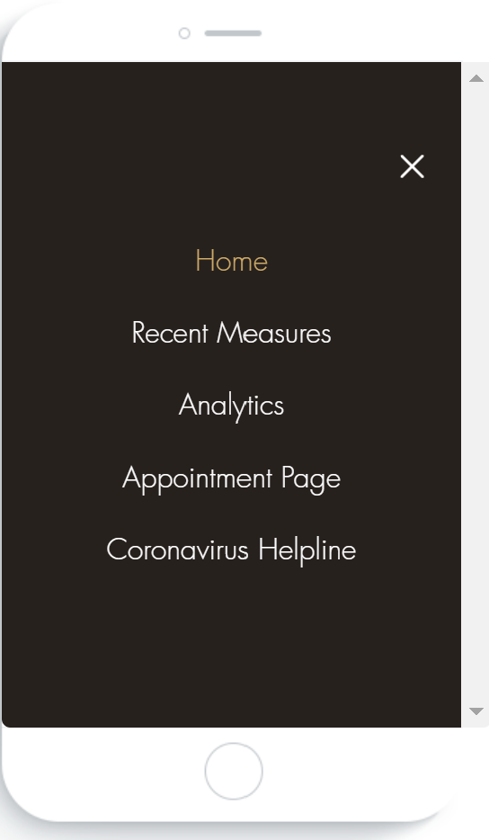
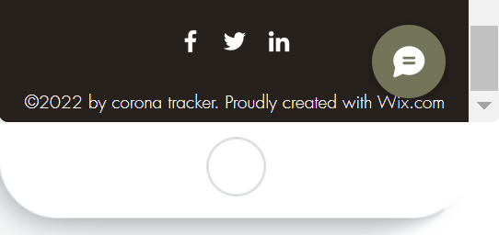
Nav bar for all pages
Footer for all pages

Slide 4
Home Page

Slide 5

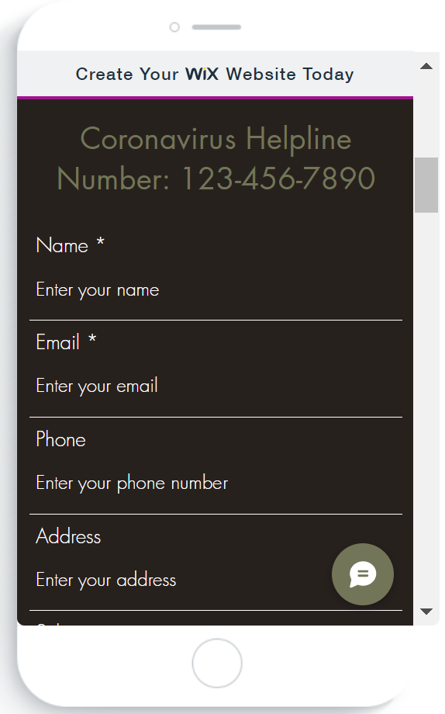
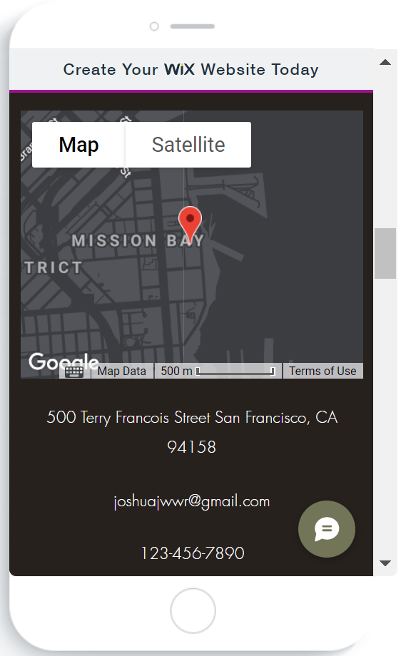

Slide 6




Slide 7
Recent Measures Page

Slide 8



Slide 9
Analytics Page

Slide 10


Slide 11
Appointment Page

Slide 12


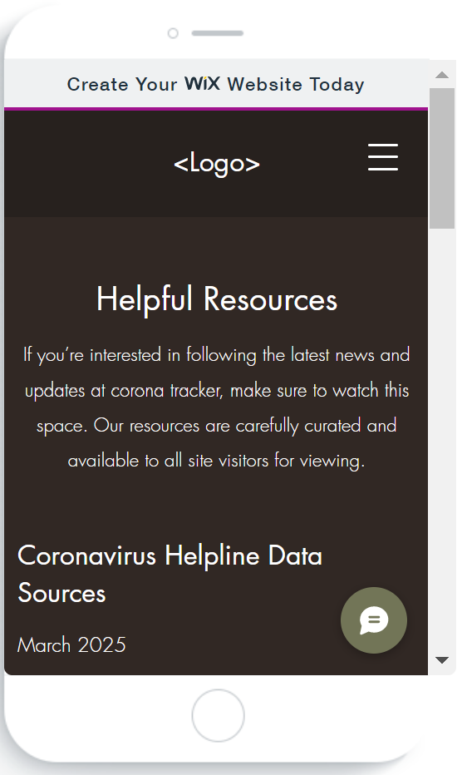

Slide 13
Helpline Page

Slide 14
